Slide 1

Electronics Project – Temperature and Humidity Sensor & Internet Transmitter.
Edmund Agyekum

Slide 2

Components
Arduino Uno R3
RGB LCD Shield Kit w/ 16x2 Character Display
Arduino Ethernet Shield
Computer capable of running Arduino IDE
Computer capable of connecting to the internet

Slide 3
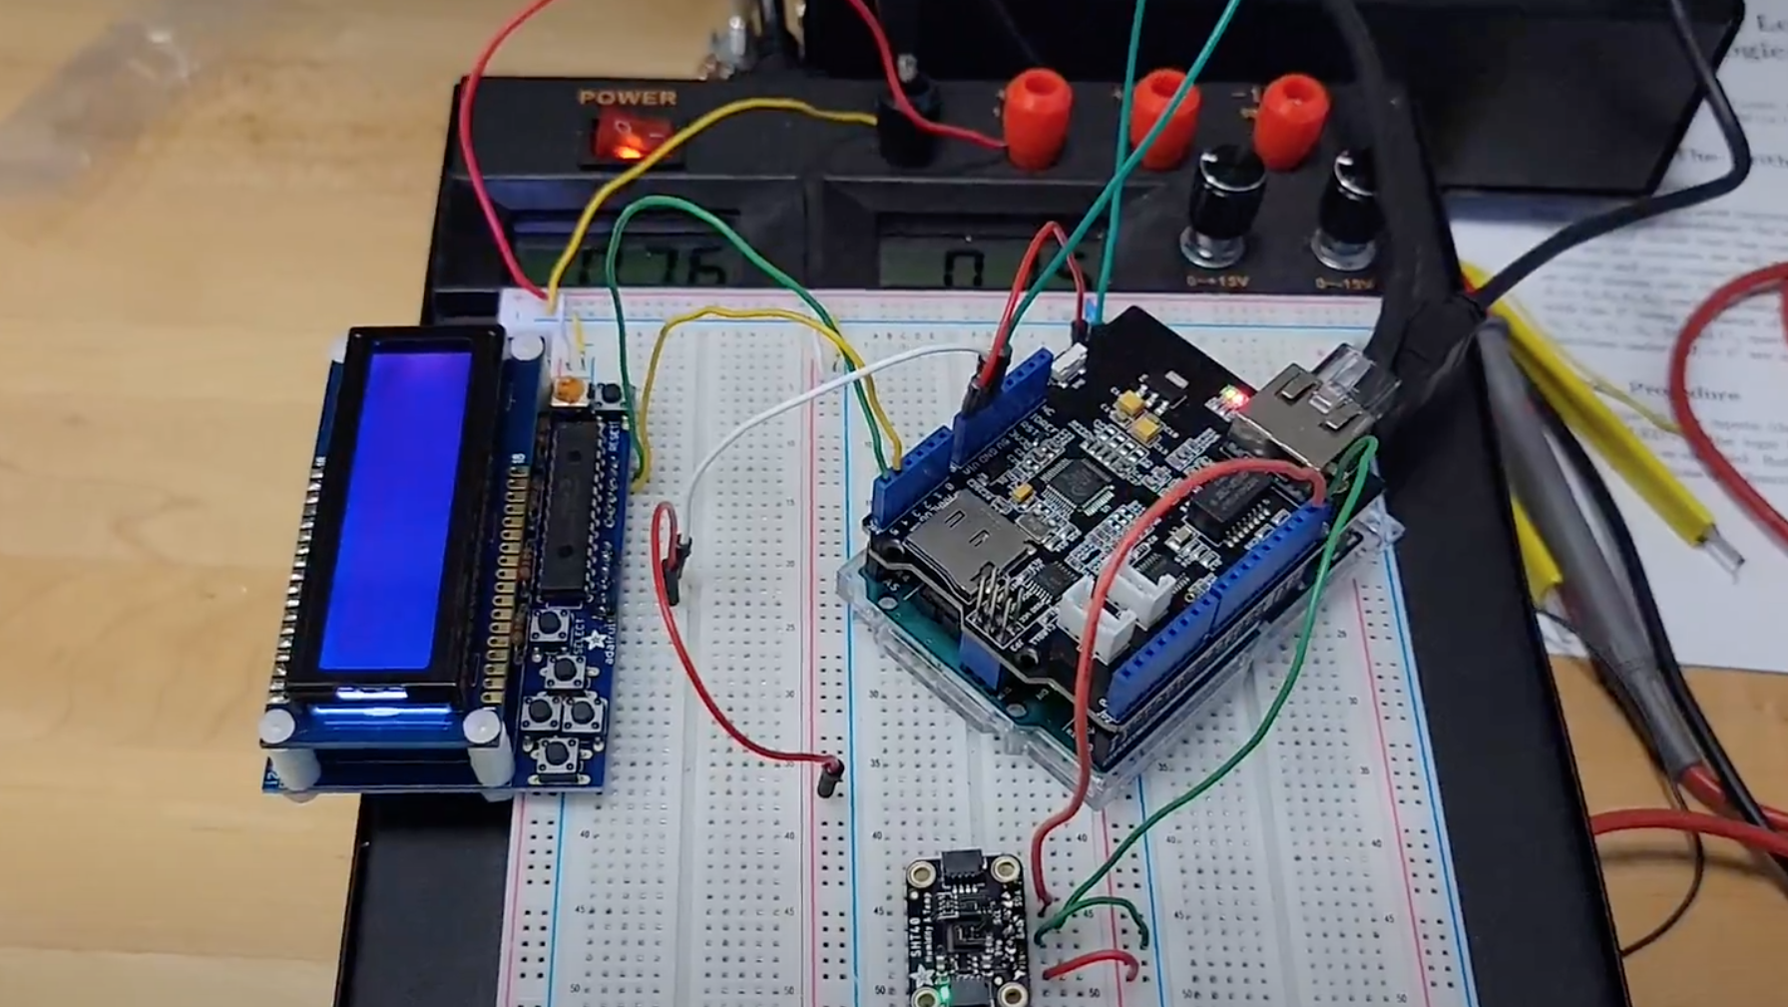
The combination of the Arduino Uno R3 and the Arduino Ethernet Shield allows for a whole new dimension of possibilities with what you can do with the board. It allows to to transmit and receive data from any computer that is capable of doing so as long as an internet connection is available. In my project, I designed a practical application of this through the reading of the temperature and humidity which is displayed by the RGB LCD Shield Kit. Followed by the input of this data (by the user for now) into a secondary program for transmission to a hosting server whereby data can be accessed from anywhere an internet connection is available.

Slide 4
Future Changes and Improvements
1. In the future, I would like to make the transmission of this data autonomous. I can do this by storing the data locally before transmission. This can be done through an SD card installed on the Arduino R3 Board.
2. So far, a commercial server is used which, although may cost a fee for its upkeep, provides tools such as graph plotting and management of multiple devices and sensors all in one central location. A custom, locally one server could be used instead if one prefers for convenience.

Slide 5
Thank You!
Sources:
https://asksensors.com/
https://www.instructables.com/How-to-Send-Data-to-AskSensors-With-Arduino-Ethern/
https://learn.adafruit.com/rgb-lcd-shield/using-the-rgb-lcd-shield
https://learn.adafruit.com/adafruit-sht40-temperature-humidity-sensor/arduino

